Slide 1
// COMPUTER GRAPHICS PROJECT
AIMLABS 3D
Python · First-Person Aim Trainer · Real-Time 3D Rendering
OpenGL 3.3
Python 3.10+
ModernGL
GLSL Shaders
Ankush Kapoor 24102C0011
Kshitij Kadam 24102C0012
Yash Waghmare 24102C0031
Shlok Bagwe 24102C0037
github.com/ankushhKapoor/aimlabs

Slide 2
01 / INTUITION
What is AimLabs 3D?
AimLabs 3D is a fully interactive first-person aim trainer built entirely in Python. It renders a real-time 3D world using OpenGL 3.3 via ModernGL, featuring live target tracking, physics-based movement, per-frame lighting, and a complete HUD system, all without a game engine.
WHY BUILD THIS?
Apply CG theory hands-on in a live app
Understand the full OpenGL rendering pipeline
Build a playable game with no game engine
Explore shader programming and ray-casting math
3
2
0
GLSL Shaders
Game Modes
Game Engines
AIMLABS 3D · COMPUTER GRAPHICS PROJECT

Slide 3
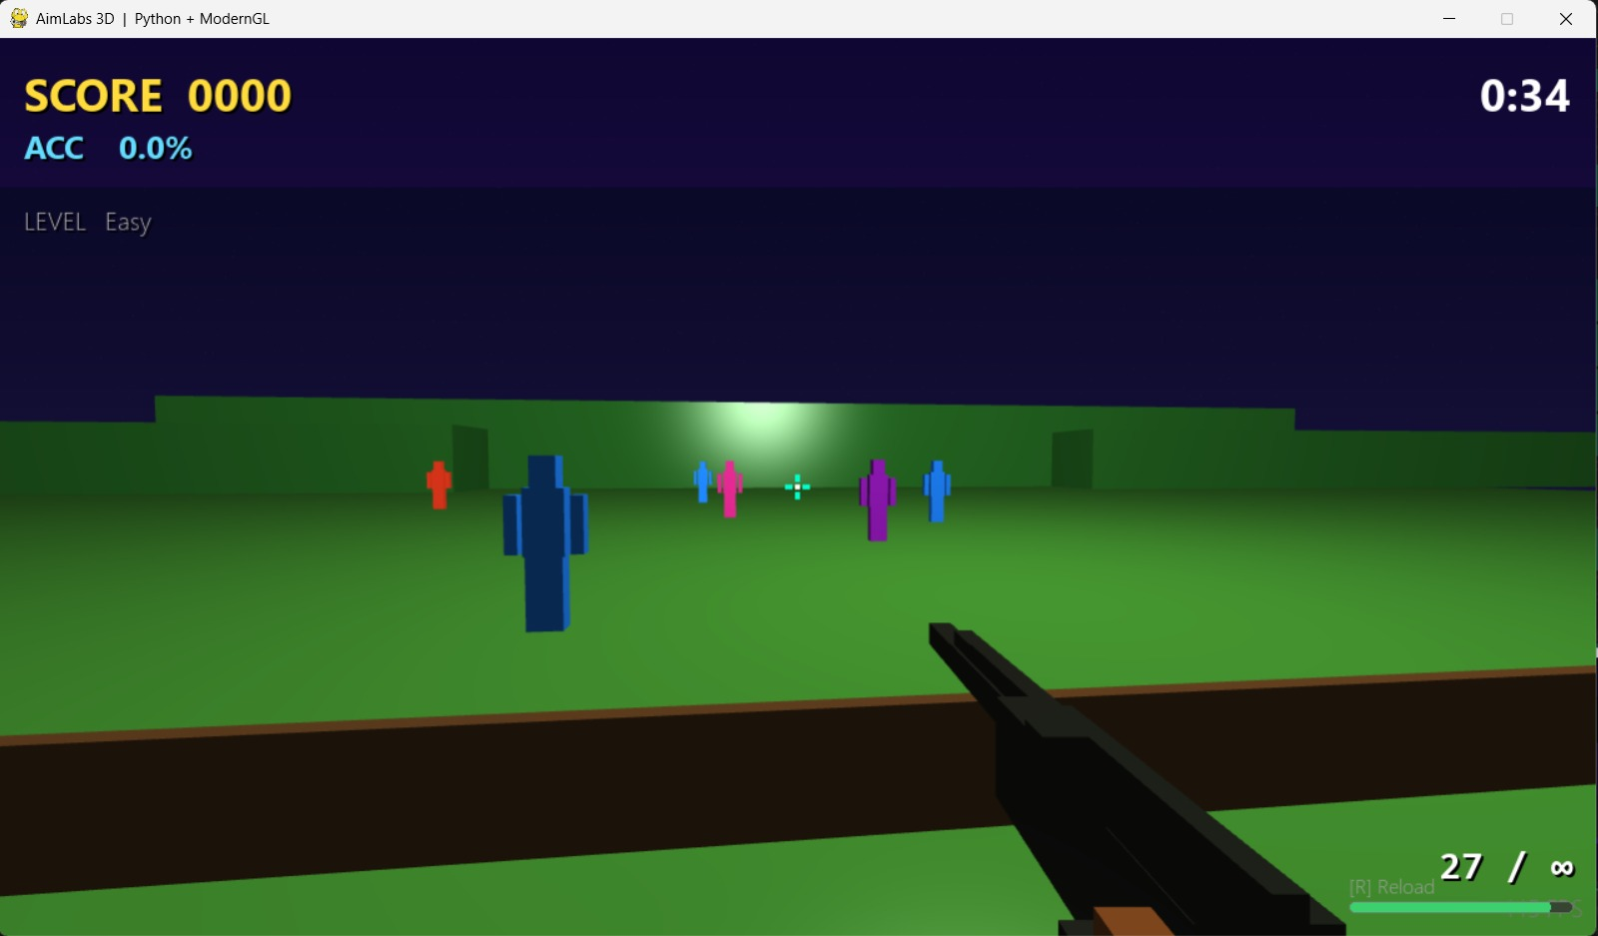
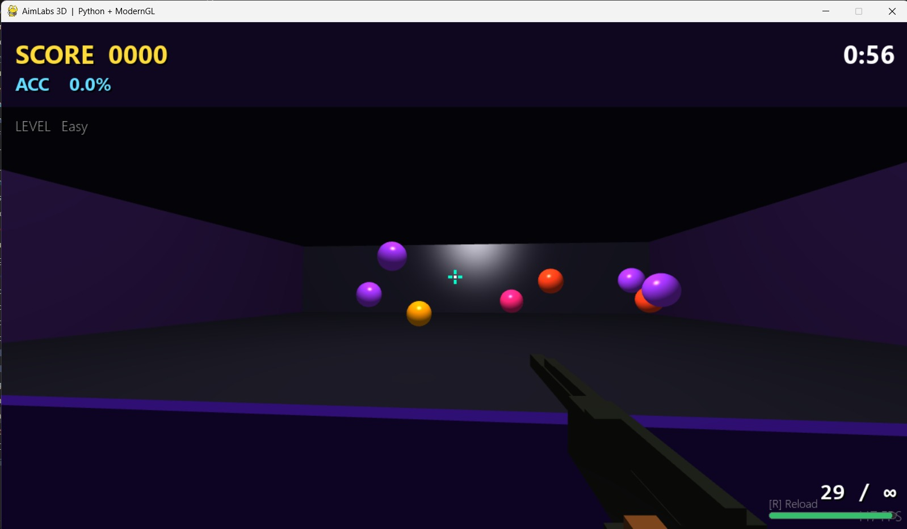
02 / GAMEPLAY
Game in Action
FIELD MODE · Humanoid Targets
ARENA MODE · Sphere Targets with Phong Shading
AIMLABS 3D · COMPUTER GRAPHICS PROJECT

Slide 4
03 / WORKING
How It Works
1
Input Handling
2
Game State Update
Pygame captures mouse and keyboard every frame. Mouse delta updates camera yaw and pitch. WASD maps to velocity vector.
Targets move and pulse. Obstacles toggle. Gun recoil and reload timeline advance. Score and timer tick each frame.
3
Shoot Resolution
4
Render Pass
Ray cast from camera origin in look direction. Analytic ray sphere test on all targets and obstacles. Nearest valid hit wins.
Clear then Skybox (depth off) then World panels then Obstacles then Targets then Gun (view-space) then HUD (depth off).
5
Shader Execution
6
HUD and Display
Each draw call runs GLSL vertex and fragment shaders. Uniforms set per object: MVP matrices, color, hit_flash, stripe_mode.
Pygame surfaces rendered to GL texture. Score, accuracy, ammo, crosshair, vignette composited over 3D scene.
AIMLABS 3D · COMPUTER GRAPHICS PROJECT

Slide 5
04 / FEATURES
Key Features
Two Game Modes
Dynamic Difficulty
Arena mode with sphere targets and Field mode with humanoid targets. Toggle with M key pre-game or while paused.
DifficultyManager scales target count, speed, and size every 8 hits. Obstacles only appear at level 3 and above.
Realistic Gun Model
Procedural Audio
AK-47 mesh with recoil animation, ammo tracking, manual and auto reload, and view-space rendering so it stays always visible.
Shot and reload from .mp3 assets. Hit ping synthesised in NumPy at runtime. Graceful fallback when files unavailable.
Full HUD System
Performance Optimised
Score, accuracy, streak, timer, ammo counter, and crosshair. State-keyed caching avoids unnecessary texture rebuilds.
VAO/VBO cached per mesh type. HUD texture only rebuilt on state change. Single unified render loop with depth toggling.
AIMLABS 3D · COMPUTER GRAPHICS PROJECT

Slide 6
05 / COMPUTER GRAPHICS CONCEPTS
CG Concepts Used
Translation
Scaling
Rotation
Moving objects to positions in 3D world space
Resizing targets and objects using scale matrix
Rotating objects and camera using rotation matrix
Projection
Vertex Shader
Fragment Shader
Perspective projection converts 3D scene to 2D screen
GPU program that transforms each vertex position
GPU program that computes the color of each pixel
Phong Lighting
View Matrix
Depth Buffering
Ambient, diffuse and specular light per surface
Camera look direction defines the view of the scene
Tracks which object is closest to camera per pixel
Texture Mapping
Ray Casting
Mesh Generation
Mapping HUD surface image onto a flat quad
Shooting a ray from camera to detect target hits
Building sphere and humanoid geometry from code
AIMLABS 3D · COMPUTER GRAPHICS PROJECT

Slide 7
06 / CODE ARCHITECTURE
Code Architecture
ENGINE LAYER
GAME LAYER
GLSL SHADERS
engine/window.py
game/target.py
phong.vert/.frag
GL context, swap, dt/fps
Sphere and humanoid targets
geometry, lighting, flash
skybox.vert/.frag
engine/camera.py
game/raycaster.py
star field, time animation
FPS look, matrices, ray
analytic ray-sphere hit
hud.vert/.frag
overlays, crosshair, vignette
engine/shader.py
game/gun.py
load, compile, cache GLSL
AK model, ammo, recoil
engine/mesh.py
game/obstacle.py
ENTRY POINT
VAO: Sphere, Box, Quad
blinking penalty targets
main.py
engine/renderer.py
game/score.py
Orchestrates all layers: init, game loop, input, update, render, swap
HUD, overlays, textures
scoring, accuracy, timer
game/sound.py
audio and NumPy synthesis
AIMLABS 3D · COMPUTER GRAPHICS PROJECT

Slide 8
07 / SCALING
Scaling the Project
GRAPHICS
GAMEPLAY
Shadow mapping with directional or point lights
Networked multiplayer via socket or WebSocket
Normal and specular maps on targets and walls
Ranked leaderboard and persistent player stats
Frustum culling to skip off-screen draw calls
Custom scenario editor with save/load config files
Post-processing: bloom, motion blur, SSAO
Additional weapons with unique recoil profiles
ENGINE
PLATFORM
ECS (Entity Component System) architecture
WebAssembly port via Emscripten and WebGL
Asset pipeline to load .obj and .gltf 3D models
Mobile support with touch aim and on-screen controls
Physics engine with collision, gravity, rigidbody
VR mode with stereoscopic render and head tracking
Level streaming for large arenas without stutter
Cloud replay storage and per-session analytics
AIMLABS 3D · COMPUTER GRAPHICS PROJECT

